Slide 1

OPEN A CINEMA IN SPAIN

Slide 2
Introduction
The stakeholder wants to open a new cinema as company's new business.
Cinema should has many restaurants and shopping places nearby. Transportation is also an important factor
He lists out his top 10 favorite cinemas in northern Spain with rating and I select 5 possible locations to build the cinema.

Slide 3
Possible locations
OVIEDO
GIJON
LA CORUÑA
SANTANDER
BILBAO

Slide 4
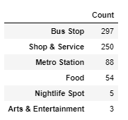
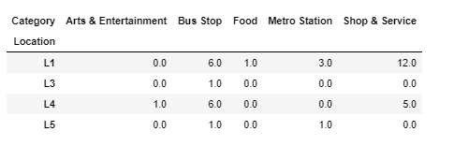
Eating, Shopping and Public transportation facility around cinemas¶

Slide 5
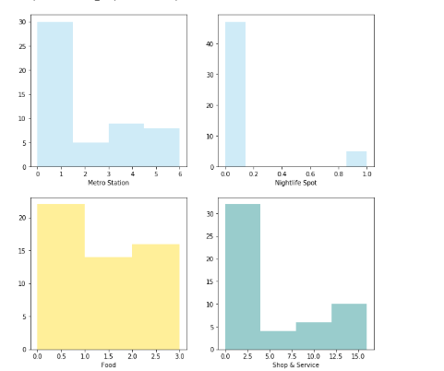
Locations life where we want to build our cinema

Slide 6
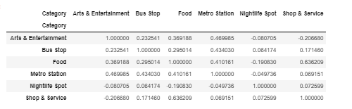
Correlation between categories
Bus Stop, Food and Shop & Service seems more correlative

Slide 7
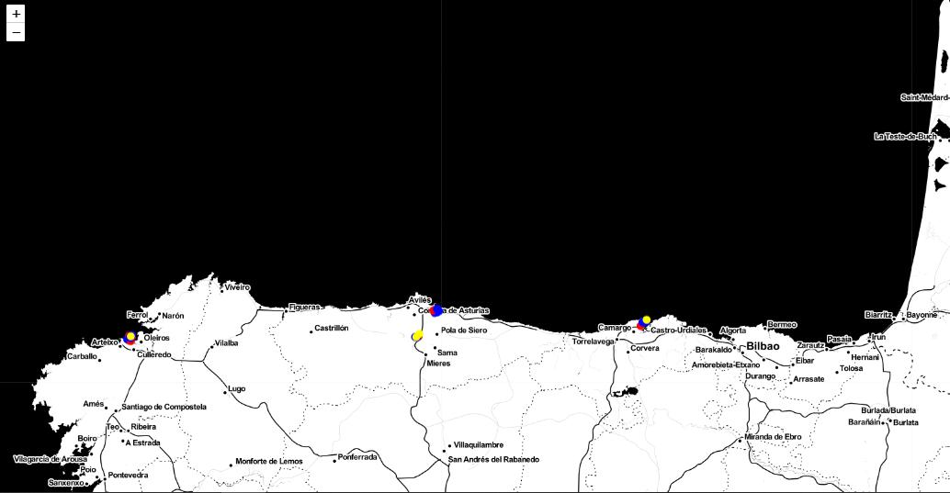
Best possible locations

Slide 8
RESULTS
Location “Gijon" has the most number of venues in category "Bus Stop", "Food", "Metro Station" and "Shop & Service“ and is the best place to open a cinema

